Slide 1
Mr. Amey Subhash Lakeshri
Email: ameylakeshri@gmail.com amey.lakeshri@in.ey.com
Contact: +91 9892632393
Linkedin: linkedin.com/in/amey-subhash-lakeshri-321211107
Webpage: https://ameylakeshri.in

Slide 2
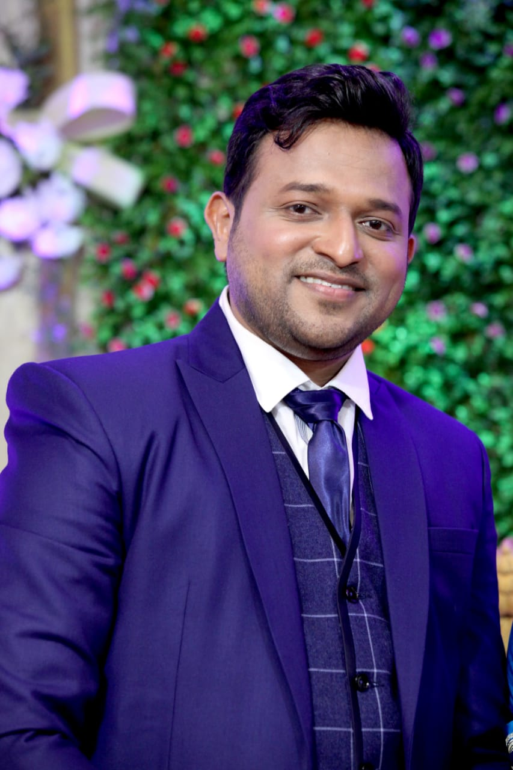
Profile
Amey Subhash Lakeshri
Mr. Amey Subhash Lakeshri is the Director of Cyber Forensic Technology and Discovery Services at Ernst & Young LLP. He has executed large scale cyber security, privacy, ransomware investigations, and compliance projects.
He has been awarded as:
Star Cyber Defender of the Year 2024
40 Under 40 Cyber
Star Cyber Defender of the Year 2024
CISO awards 2024
Smart CISO – 2024
“Cyber Leader 2023” in CIO 200 INDIA (50 countries)
“ Editors choice CISO Award 2023 ”
“ Innovative CISO 2023”
“Emerging digital leader of the year 2023”
“Cybersecurity Champion 2023”
“Innovative CISO 2023”
“Top CISO 2023”
“Global CIO 200”
“ Innovative CISO 2023”
“ Innovative Cyber Leader of the year”
“Cyber Warrior 2022”
“ Outstanding Cyber Security Professional of the year”
“Cyber Sentinel 2022”
“Data Center Champion”
“Cyber Spartan 2021 India”
“Cyber Spartan 2020 India”
“Covid19 Superhero CIO 2020”
“Infosec Cyber Sentinel 2019”
“Infosec Award 2018”
In various Infosec events of India and Global
“Exceptional Entrepreneur” by EY Forensics 2022
“Most Promising Talent of the Year 2015” Zycus
“Monthly/Quarterly Appreciation/Awards”
In Organizations Served and to be continued
A strategist and implementer with recognised proficiency in spearheading business to accomplish corporate security goals successfully. He has more than 14 years of experience in the areas of Cyber Security, Data Privacy, Compliance, Risk Management, Governance, Network Security, Security Audits, Security Strategy, and Business Development.
Amey has led knowledge sharing sessions/webinars in India and around the world for more than 500 people at a time on topics such as Cyber Security, Cyber Forensics, Ransomware and Mitigation Approach, Data Privacy, How to Enable Business Securely, and so on. In addition, an ISACA Chennai KSS Session on Cyber was held, Moderator in Security Symposium
Cover Page Presence on leading Cyber Magazine 2022
Upcoming: Part of multiple Panels in Cyber Events and CISO Round Tables
He has completed his B.E. in ExTC, with post graduation in MIM, along with various security certifications such as ISO 27001:2013, PCI DSS, CCNP, Pursing CIPM, CISM etc.

Slide 3
Thank You

